Slide 1

iSnooze
Apple
EE459, Spring 2008
Senior Design Project
Engineers: Tony Chen, Nate Houk, Ashwin Sathe

Slide 2
Objective
Simple
No feature creep
“It Just Works”™
No user manual
Intuitive
Beautiful
Sleek and hip
Doesn’t look “cheap”

Slide 3
Features
“Think Different”™
Button less
Seamless iPod integration
Simple user interface
Standard Features
Snooze
Alarm buzzer
12/24 Hour
Battery backup

Slide 4
Schematic
Bat
RTC
EEPROM
Register
I²C
Buzz
BCD Drivers
Touch
Buttons
uC
Input Bus
Data Bus
Register
Encoder
12:59
Address
Beep
Register
Sun
Mon
Tue
Wed
Thu
Fri
Sat
Serial
iPod Dock
Register

Slide 5
Touch Sensitive Buttons
QTouch Technology
Key design feature in iPod, iPhone
Allows us to design a sleek clock housing
QT110 1-Channel
Detects change in capacitance as a finger approaches the electrode
QT1103 10-Channel
QFN Package
Adjacent Key Suppression
Problems
Soldering
Tactile Feedback
Routing of wires causes unwanted capacitance

Slide 6
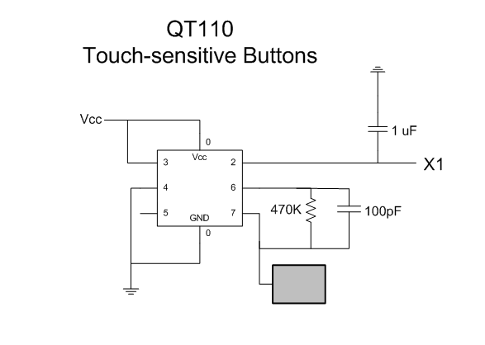

iPod Integration

Slide 7
iPod Integration
Apple Accessory Protocol
Reverse Engineered
Poor documentation
Difficult to obtain parts
Difficult to obtain robustness
Serial Communication
Accessory Indicator Resistor
Command Packets
Header
Length
Mode
Checksum = [0x100 - (length + mode + command)]
Problems
Soldering
Increase Volume Packet
sci_write(FF) ;
sci_write(55);
sci_write(03);
sci_write(02);
sci_write(00);
sci_write(02);
sci_write(F9);
// header
// length
// mode
// command
// checksum

Slide 8
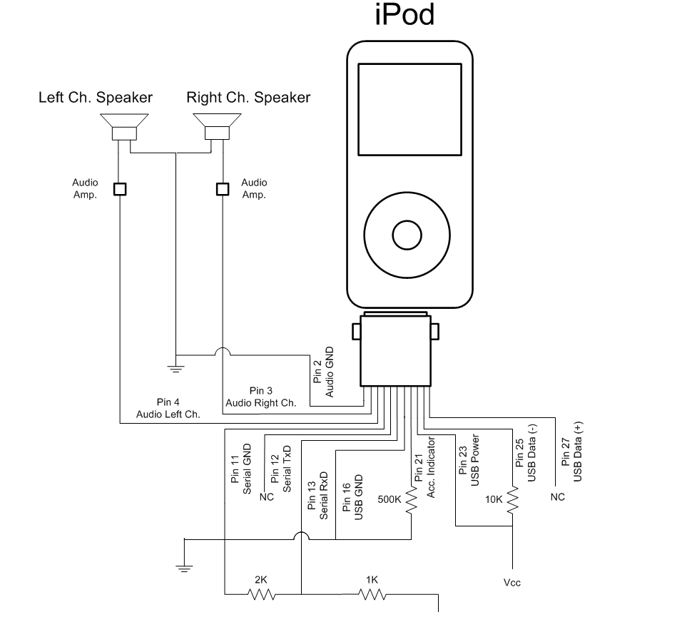
iPod Integration
uC Serial TxD

Slide 9
Demo

Slide 10
Problems
Backlight
Dead on arrival
LCD Fades
BCD Driver chips unable to sink enough current
iPod Integration
Not able to fully utilize protocol
Audio Amplification
Feedback in op-amp circuit caused audio distortion

Slide 11
Cost Analysis
Part # | Description | Qty | Bulk Price | Total
MC908JL16CPE | uC | 1 | $2.19 | $2.19
VI-319-DP-FC-S | 7-Segment LCD | 1 | $6.80 | $6.80
KIT-LED-41 | LCD Backlight | 1 | $3.25 | $3.25
LEDs |  | 14 | $0.27 | $3.78
74LS374N | Register | 4 | $0.45 | $1.80
74LS247 | BCD Converter | 4 | $0.96 | $3.84
74LS08N | Hex AND Gate | 1 | $0.32 | $0.32
74LS138N | 3-8 Decoder | 1 | $0.41 | $0.41
74LS148N | 8-3 Encoder | 2 | $0.80 | $0.80
DS1307 | RTC | 1 | $1.69 | $1.69
24LC256 | EEPROM 256k | 1 | $1.35 | $1.35
DS32KHZ | Oscillator | 1 | $2.55 | $2.55
10Mhz | Oscillator | 1 | $1.27 | $1.27
QT1103 |  | 1 | $2.17 | $2.17
Resistors Pack | 330Ω, 1Ω , 2Ω, 10KΩ , 500KΩ | 6 | $.31 | $1.86

Slide 12
Cost Analysis
Part # | Description | Qty | Bulk Price | Total
Capacitors | 100pF, .1uF | 20 | $0.10 | $2.00
3.3v Battery |  | 1 | $0.85 | $0.85
Speakers |  | 2 | $1.59 | $3.18
Buzzer |  | 1 | $0.50 | $0.50
Piezo Speaker |  | 1 | $0.50 | $0.50
iPod Dock Adaptor |  | 1 | $0.50 | $0.50
AC Adaptor |  | 1 | $4.35 | $4.35
 |  |  | Total | $45.96
 | Apple Volume Discount 20% |  |  | -$9.19
 |  |  | Cost Basis | $36.77
 |  |  | Price Point | $49.99
 |  |  | Profit | $13.22
 |  |  | Profit Margin | 26.4%

Slide 13
Questions?

